Slide 1
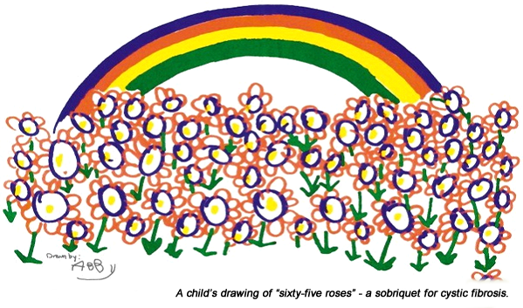
Adult CF Clinic Introduction
George M. Solomon, MD
Assistant Professor of Medicine
Adult CF Center Director
Associate Scientist – Gregory Fleming James CF Center
Associate Program Director – UAB Pulmonary and Critical Care Medicine Fellowship
COVID19 Updates
May 4, 2020
Adult Cystic Fibrosis Clinic
Gregory Fleming James Cystic Fibrosis Center

Slide 3
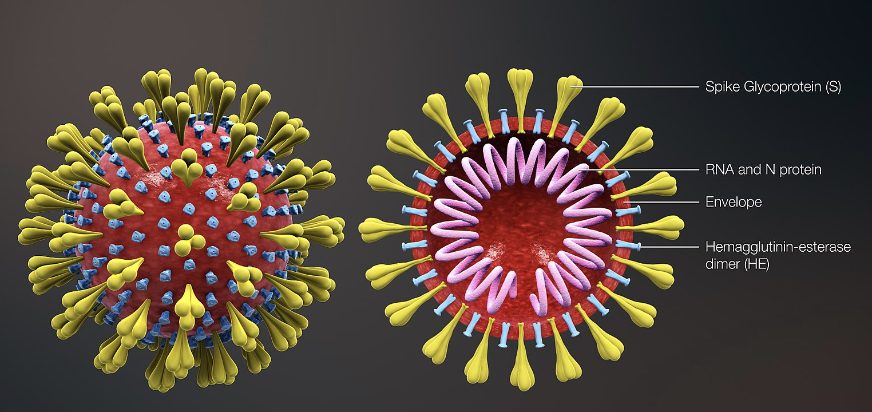

Slide 4
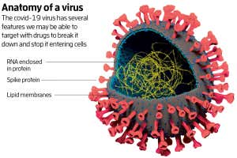

Slide 5
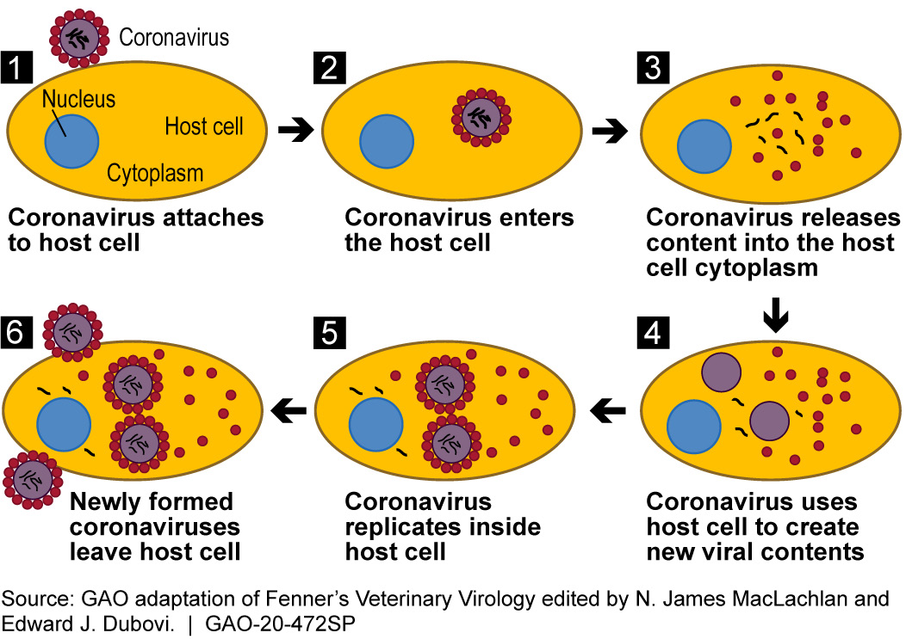

Slide 6
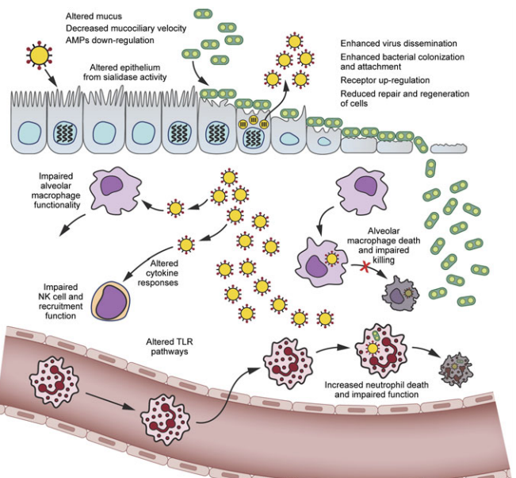
Smith & McCullers 2014; Current Topics in Microbiology and Immunology

Slide 7
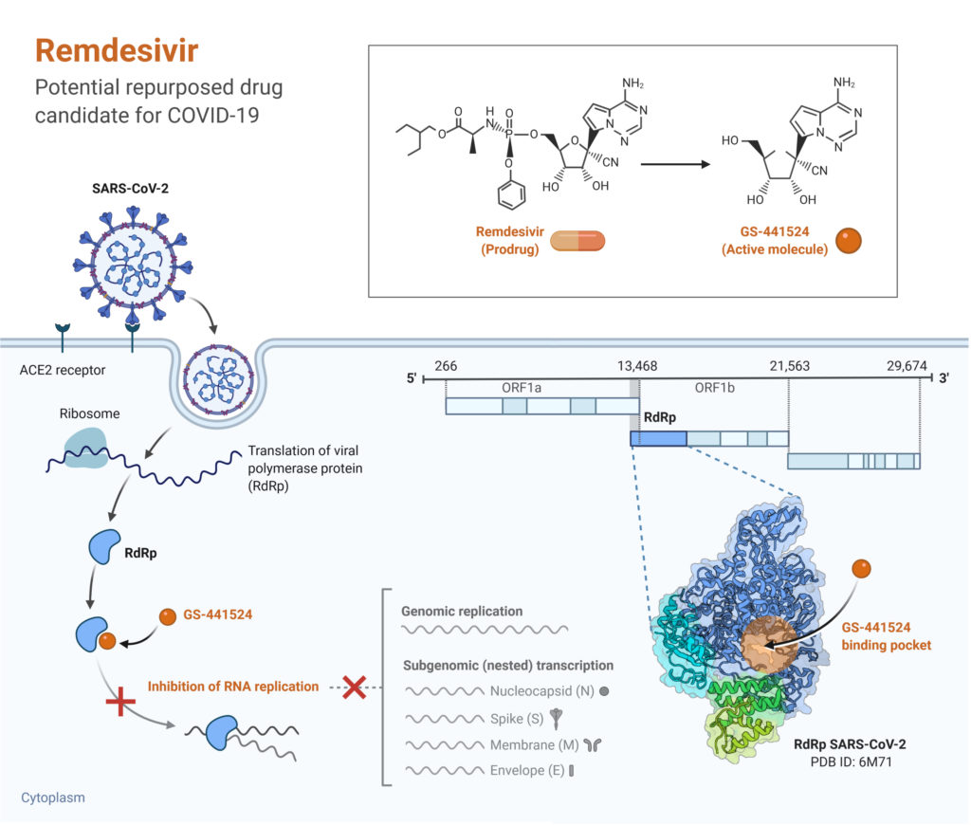

Slide 8
Remdesivir
Safe and individually effective in
Early RCT data shows improvement in time of recovery and data is close on mortality but not finalized
FDA cleared it for use in sick, hospitalized patients
Where it’s unclear:
Milder disease
Prophylaxis

Slide 9
Vaccines

Slide 10
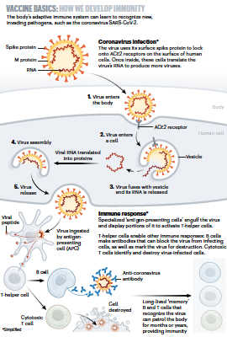
Nature 30 April 20202

Slide 11
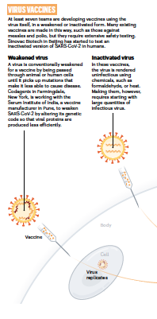
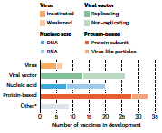
Nature 30 April 20202

Slide 12
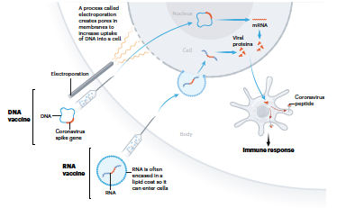
Some Vaccines Use the DNA/RNA of the Virus to Stimulate the Immune Response
Nature 30 April 20202

Slide 13
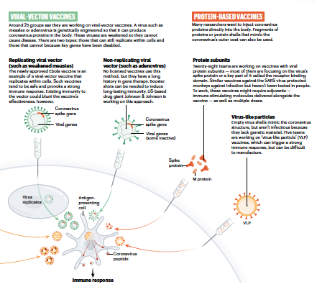
Some Vaccines Use Other Viruses or Proteins to Inject DNA directly
Nature 30 April 20202

Slide 14
Am I at Risk?
It’s unclear if PCD poses a signficant risk but we do know that worsening lung disease is very detrimental to people with chronic lung diseases already!
A small CF study suggested low rates of infection and mild illness but cannot conclude that bronchiectasis illnesses are protective!

Slide 15
What You should Do?
Stay Close to Home and socially distant
Extend these measures well beyond what state/local officials
Await contact tracing and other advanced mitigation efforts before you return to usual day to day activities

